Slide 1


Syllable Stress
At the end of this lesson you will :
Know what a syllable is.
Know what syllable stress is.
Know why syllable stress is important.
Learn to listen for syllable Stress

Slide 2
What is a syllable?
A separate sound within a word that contains a vowel sound.
Examples: “computer” has three separate sounds – COM PU TER
Each sound contains a vowel sound
A E I O U

Slide 3
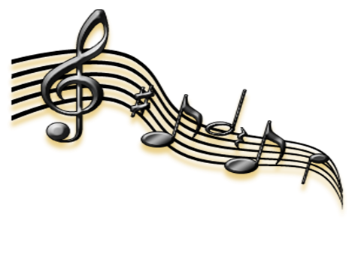
Sounds
We are talking about sounds, not spelling. So the word “Fly” is a syllable that contains the “i” sound.
The word “sadly” contains two syllables – SAD LY
Notice that the vowel sound from “y” can be pronounced as “e” or “i”
Syllables are about SOUND, they are not about SPELLING.

Slide 4

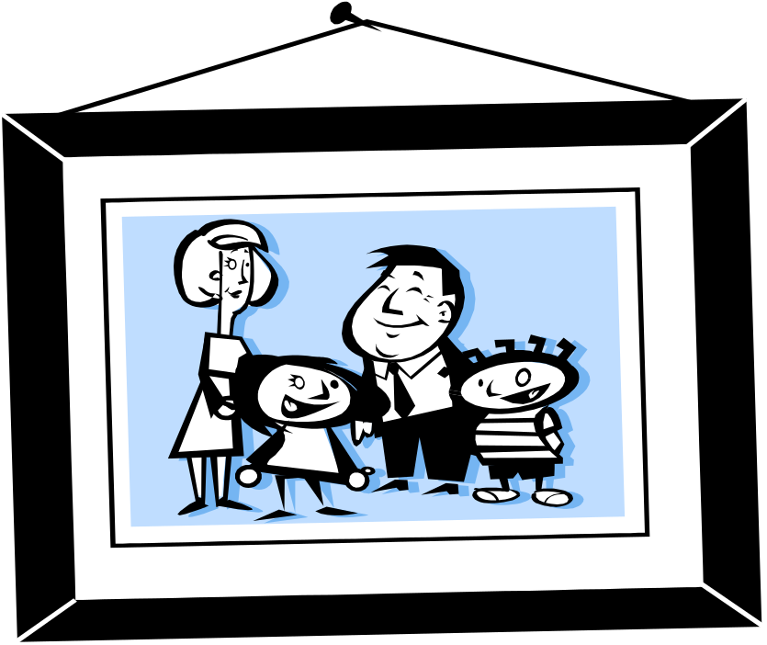
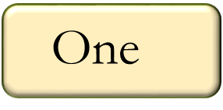
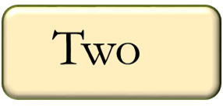
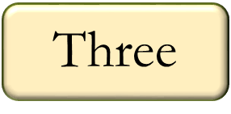
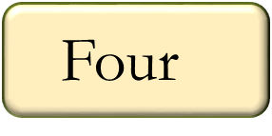
Listen to this word - Photograph
How many separate sounds do you hear?
PHO TO GRAPH
1 2 3

Slide 5
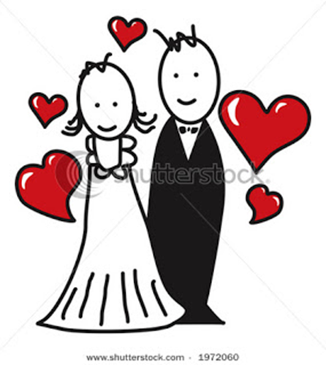

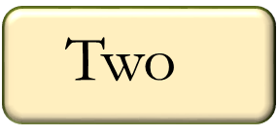


Listen to this word - Married
How many separate sounds do you hear?
Mar ried
1 2

Slide 6
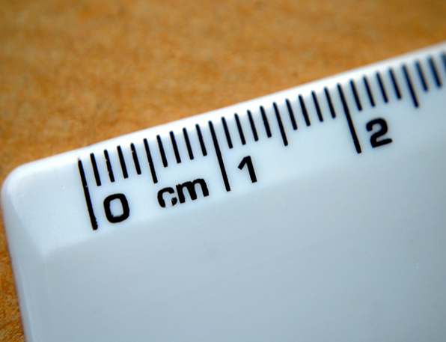
Listen to this word
How many separate sounds do you hear?
Cen ti me ter
1 2 3 4

Slide 7

This is the end of
“Number of Syllables in a word”.
Next - “Syllable Stress”
Please continue.

Slide 8
Syllable Stress – what is it?
Listen to this word – “computer”
How many syllables do you hear?
Three syllables – Com pu ter
1 2 3

Slide 9
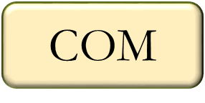
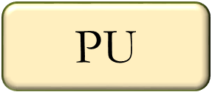
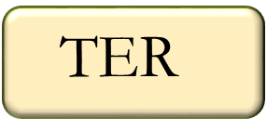
Notice that one of the syllables sounds stronger or louder than the other syllable? This is a stressed syllable.
Listen
Which syllable sounds stronger?
Computer
comPUter

Slide 10
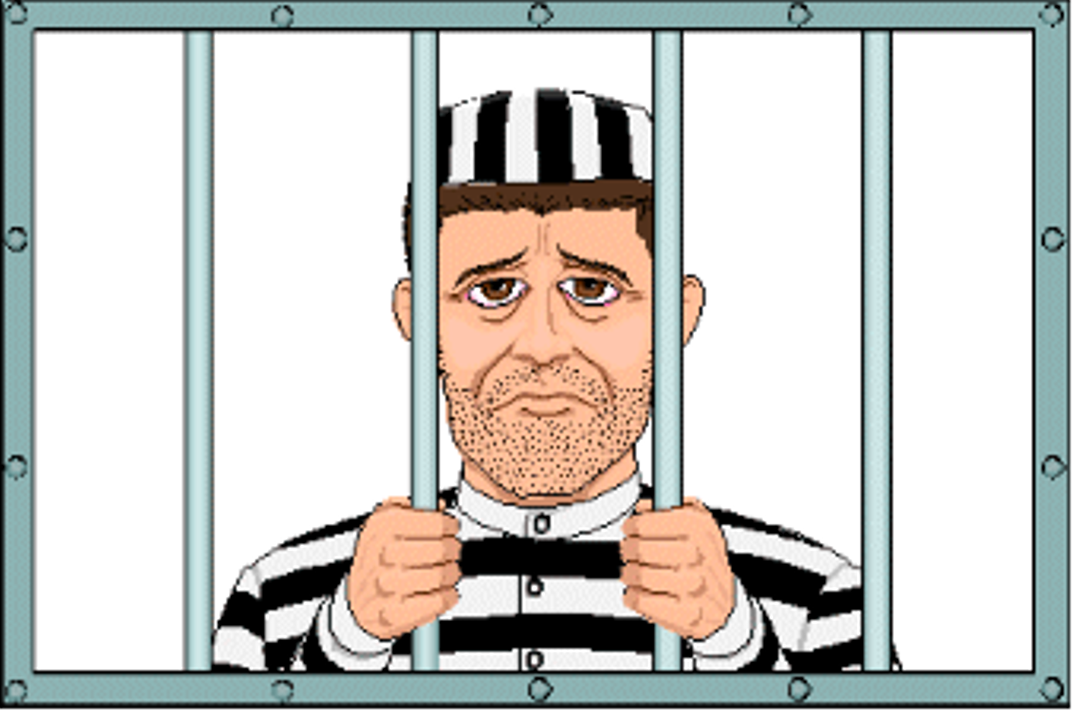
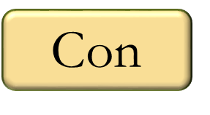
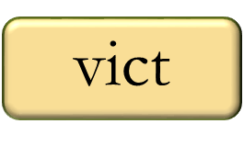
Listen to this word - Convict
Which syllable sounds stronger?
CONvict

Slide 11

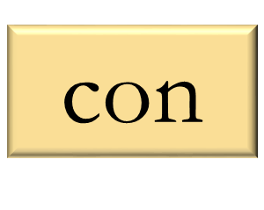
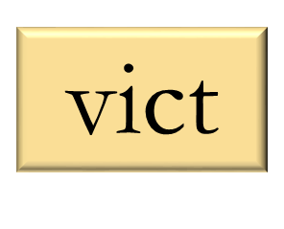
Listen to this word - Convict
Which syllable sounds stronger?
conVICT

Slide 12

Notice something?
Convict
Same spelling
Different syllable stress
Different meaning
Convict

Slide 13
Same spelling, different syllable stress
= different meaning
Noun Verb
Record | Record
Progress | Progress
Present | Present
Permit | Permit

Slide 14
We have learned that if a word has more than one syllable we stress one of the syllables.
Summary of Syllable Stress
If we stress the wrong syllable, we may change the meaning of the word.

Slide 15
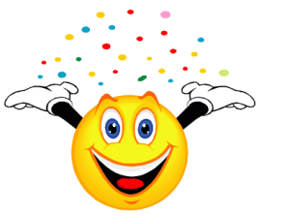
Now you know about syllable stress
When you listen to a word – listen for the strong syllable
This will help both your listening and speaking skills

