Slide 1


Reading Versus Speaking
A woman, without her , man is nothing.
A woman without her man - is nothing

Slide 2
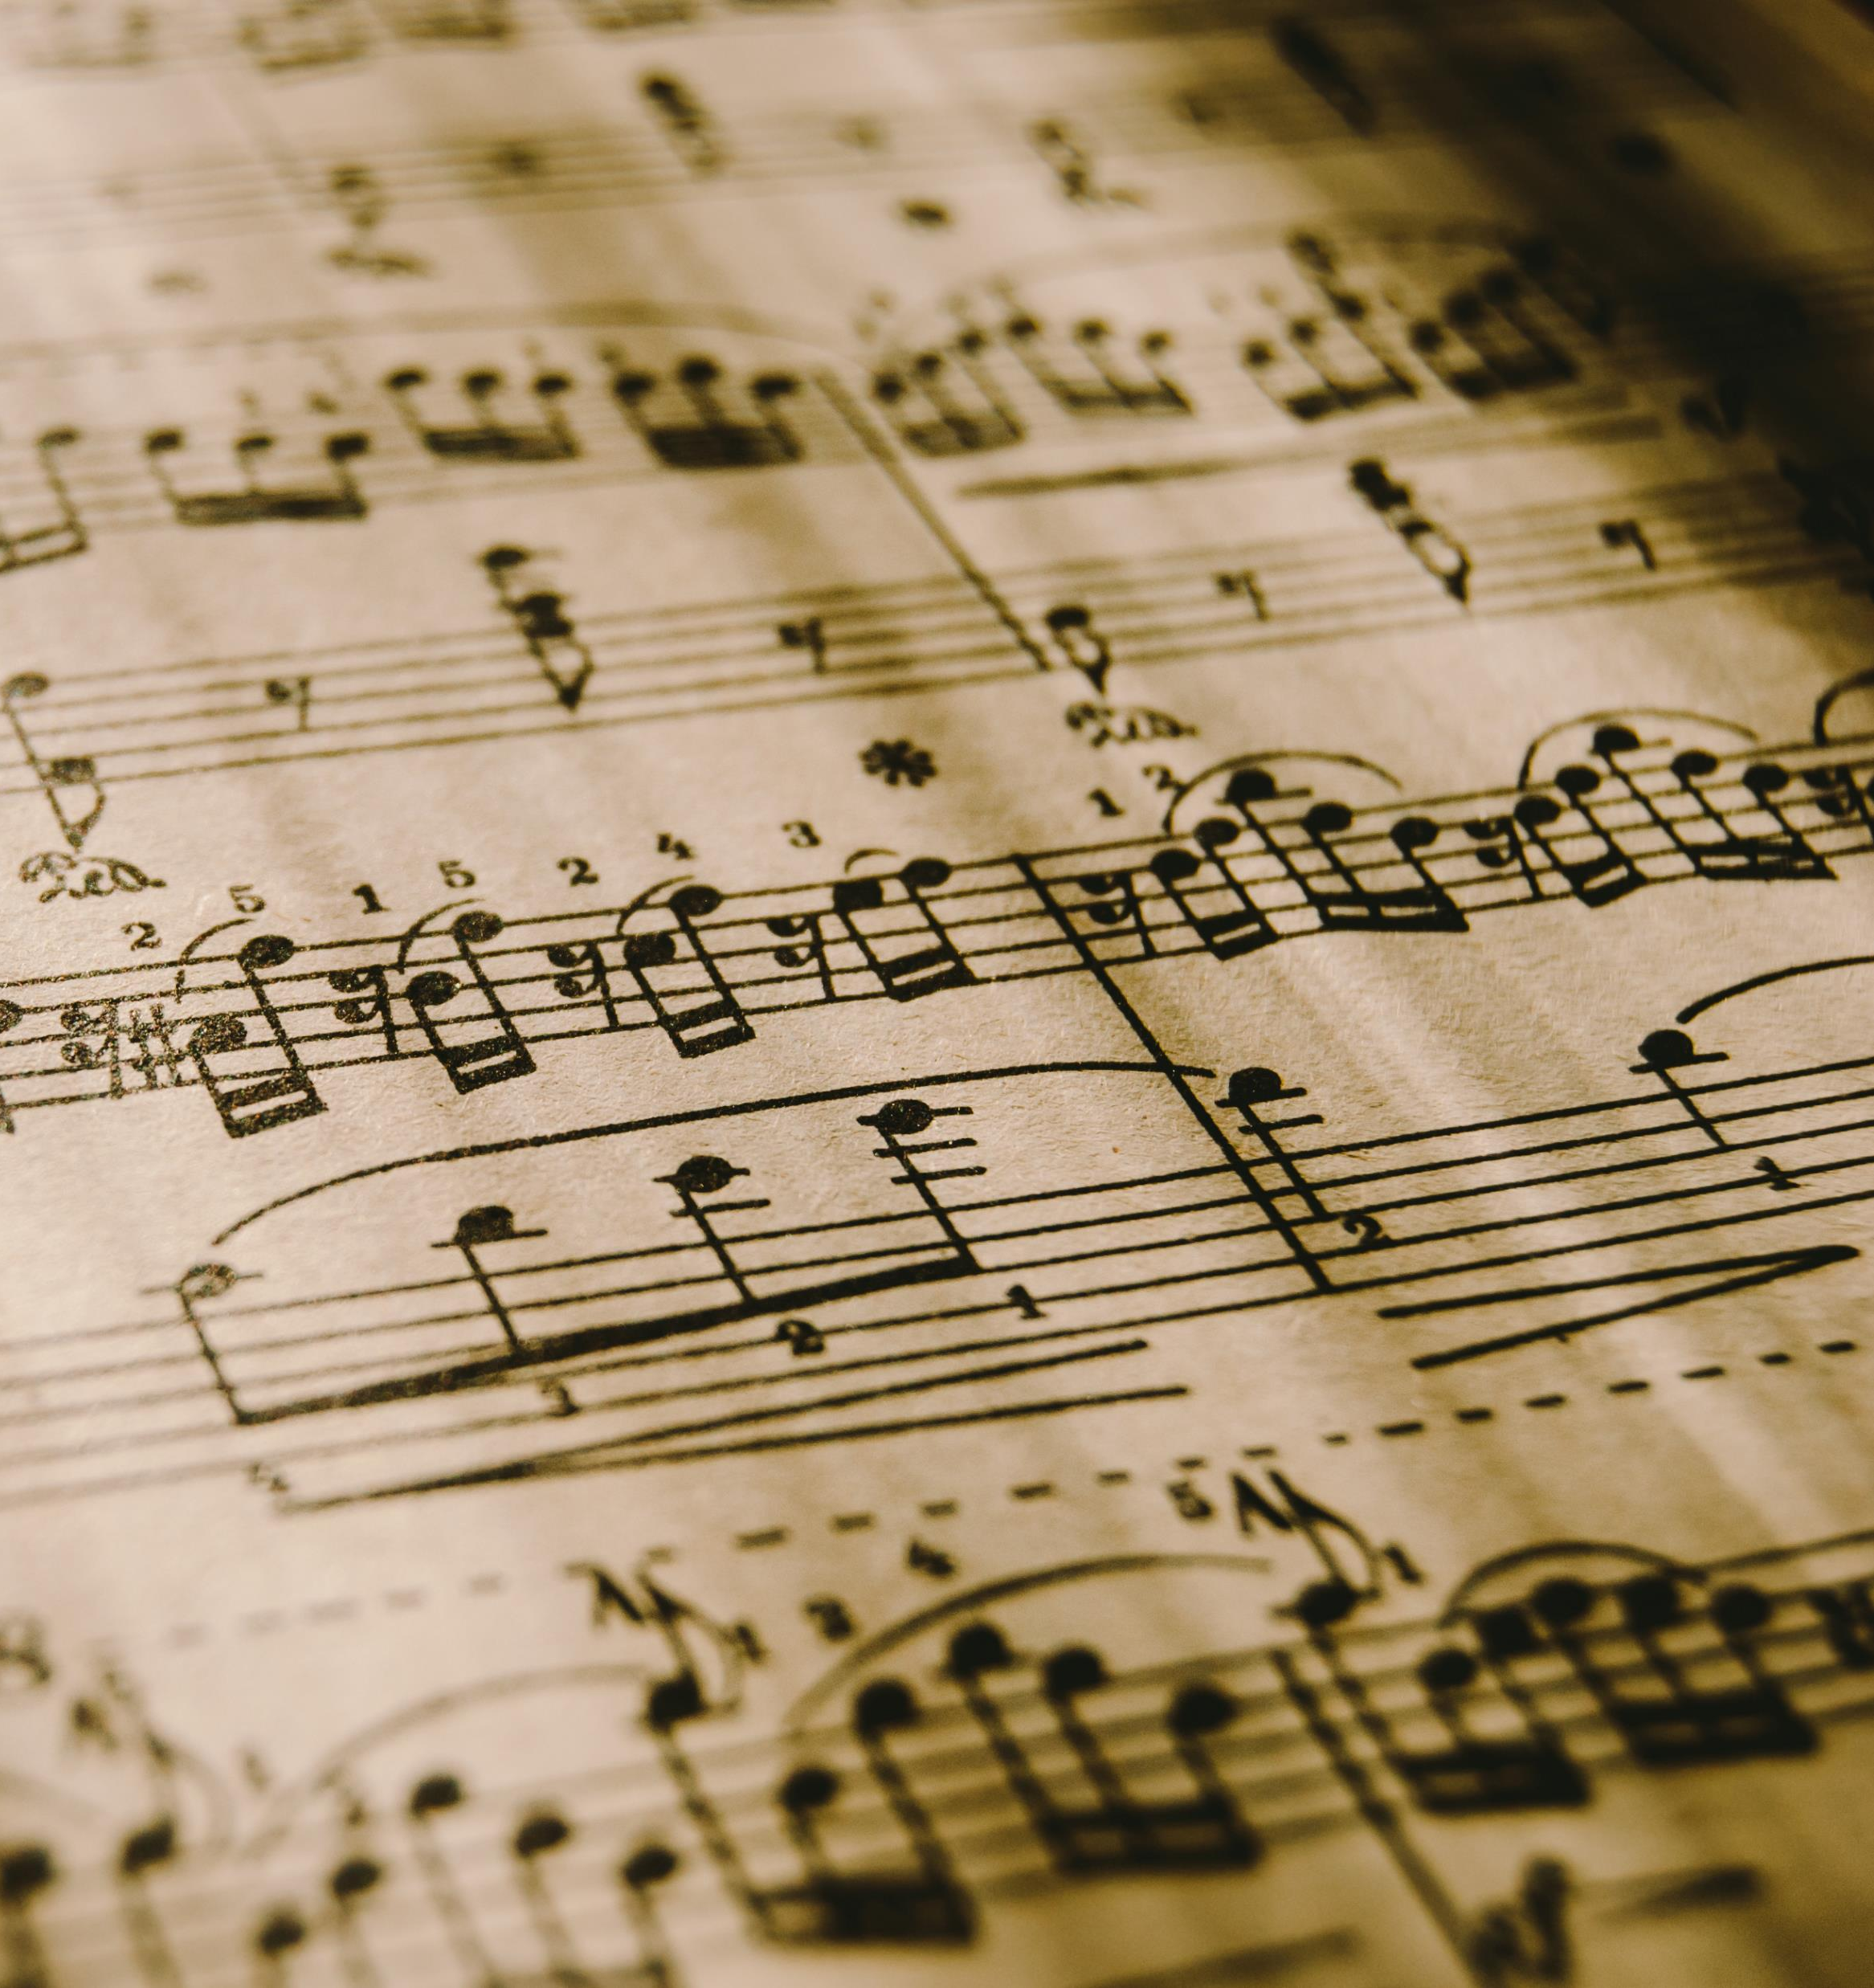
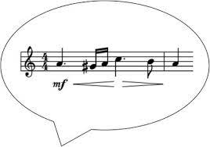
I went to the market / to buy a fish.
1. Syllable Stress
2. Word Stress
3. Linking
4. Thought Groups
Rhythm
Comprehension

Slide 3
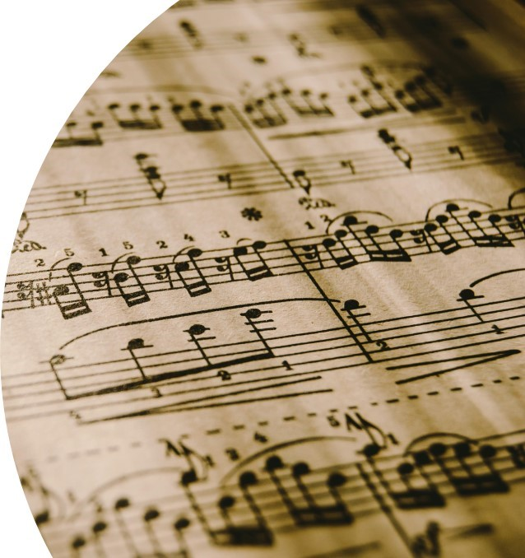
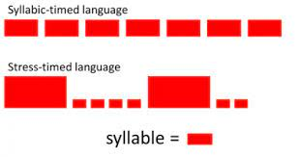
I went to the market / to buy a fish
Syllable Stress Timed Language
syl – la- bles
record a record
(V ) (N)
Lexical Stress

Slide 4
I went to the market / to buy a fish
Word Stress
Content Words
Main Verbs | Negatives
Nouns | ‘Wh’ Words
Adjectives | Interjections
Adverbs

Slide 5
I went to the market / to buy a fish
Linking
Similar Sounds

Slide 6
I went to the market / to buy a fish
 | V-V |  | C-C |  | C-V
I am | Iyam | handbag | han(d)bag | take it | tay-kit
She is | Sheyis | landmark | lan(d)mark | Look at | Loo-kat
Do it | Duwit | hot tea | hohtea | Stop it | Sto-pit
Go out | Gowout | next week | neksweek | Have it | Ha-vit

Slide 7
I went to the market / to buy a fish
Linking
Similar Sounds
? Fluid Word Transition
Maintain Rhythm

Slide 8
I went to the market / to buy a fish
Thought Groups
a. Aural recognition of the boundaries between related groups of words.
b. Falling intonation
Meaningful Units:
Pause or Break
Stress and Intonation

Slide 9
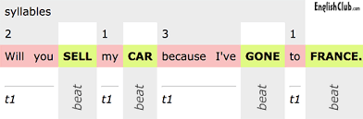
I went to the market / to buy a fish
Rhythm

Slide 10
4 techniques give the Rhythm to English Speech
This Rhythm is essential for comprehension
1. Syllable Stress
2. Word Stress
3. Linking
4. Thought Groups
Rhythm
Comprehension

Slide 11

Summary
    Better Listening Skills
    Improved Speaking Skills
  - Fluency
    Improved Writing Skills
- Syntax
    Develops Language
Competence

Slide 12
